Slide 1
Class 7: Native American Language and Culture Educator Licensure Tribal Caucus
March 18, 2021
Notes:
The USED Assessment Team is in the process of meeting with States that have submitted waivers of assessment requirements.
We would like to meet with you regarding Montana’s waiver request. The purpose of the meeting is to:
Inquire (since the release of the guidance on February 22, 2021) if the State has questions about its waiver.
Learn if Montana would like to amend its waiver request to clarify what has been submitted.
Discuss other concerns about Montana’s waiver request.

Slide 2
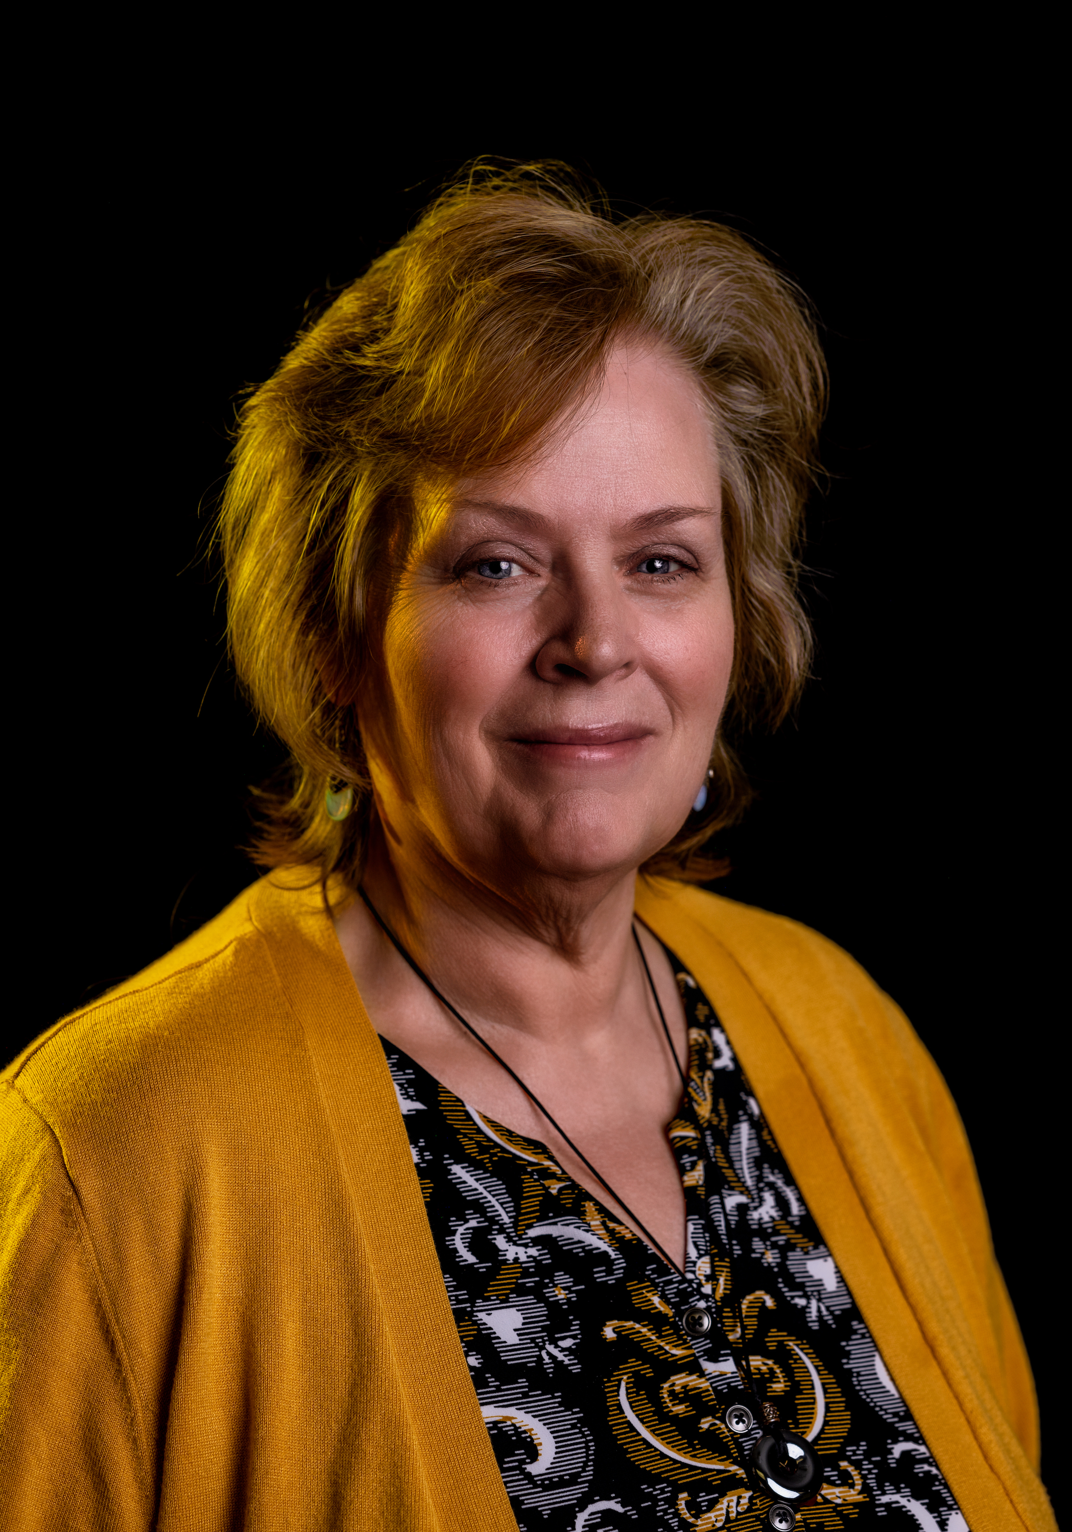
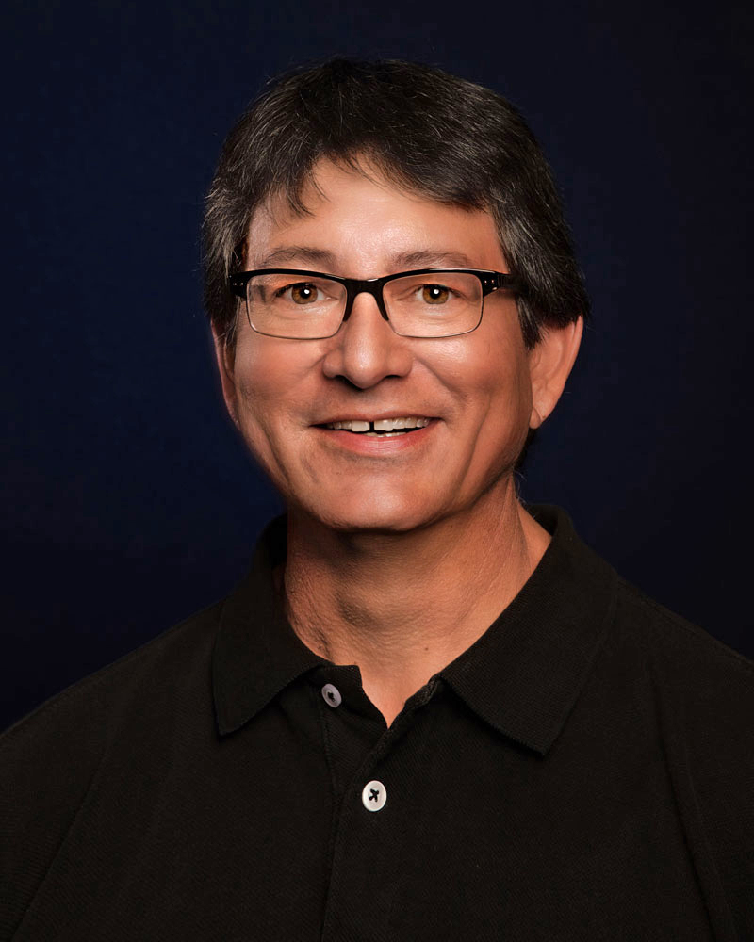
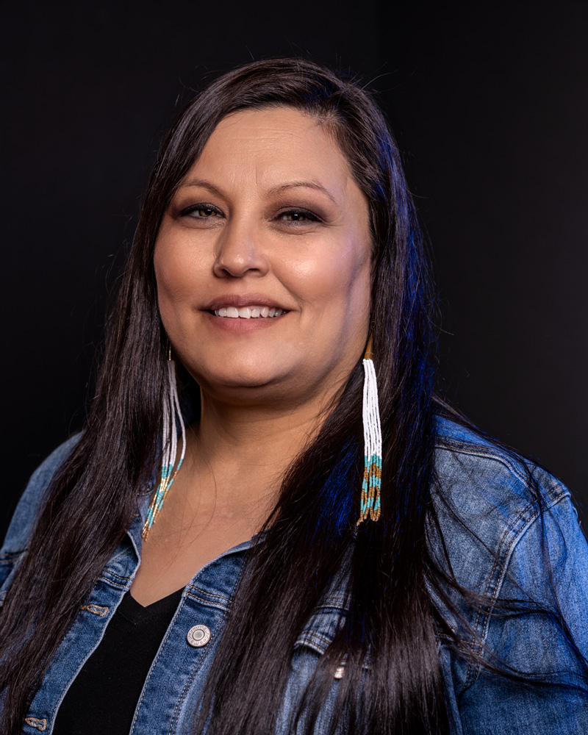
OPI Presenters
SHARYL ALLEN, DEPUTY SUPERINTENDENT
406.444.5658
Sharyl.Allen@mt.gov
MIKE JETTY, INDIAN EDUCATION SPECIALIST
406.444.0720
mjetty@mt.gov
JULIE MURGEL, SENIOR MANAGER FOR DEPARTMENT OF SCHOOL INNOVATION AND IMPROVEMENT
406.444.3172
Julie.Murgel@mt.gov
LONA RUNNING WOLF, DIRECTOR OF AMERICAN INDIAN STUDENT ACHIEVEMENT
406.444.3013
Lona.RunningWolf@mt.gov

Slide 3
The purpose of the presentation
Provide an overview and current data of the Class 7 Licenses.
Review role and responsibility of Tribal Councils for the Class 7 license.
Inquire if the Tribal Caucus has questions or recommendations about the Class 7 License.

Slide 4
Class 7 American Indian Language and Culture Specialist
In November 1995, the Board of Public Education (supported unanimously by Montana tribes) approved a certification titled “Class 7 American Indian Language and Culture Specialist” to teach Native American language.
The Class 7 certificate was put in place to ensure quality Native language instruction for Montana’s children.

Slide 5
ARM 10.57.436
Valid for five years.
Issued based upon verification by the authorized representative of a tribal government, that has a MOU with the Superintendent, that the applicant has met tribal standards for competency and fluency.
BPE will accept and place on file the criteria developed by each tribe for qualifying an individual as competent to be a specialist.
May be approved to teach traffic education.
May be renewed upon verification by the tribe that the PD plan, as defined by the MOU is met.
A school district may assign licensee to only specialist services within the field of American Indian language and culture as the district may deem appropriate.
No other teaching license or endorsement is required for duties within this prescribed field.

Slide 6
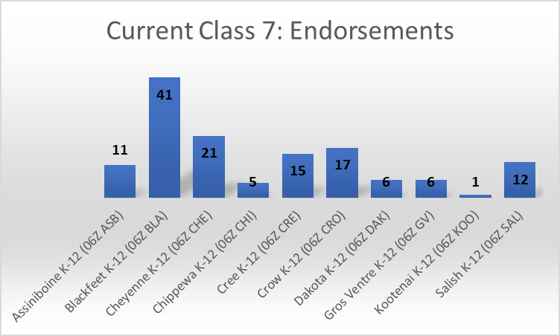
Class 7 Licensees : Total 135
NOTE: There are duplicates in this count, because this is counting endorsements, not license holders.

Slide 7
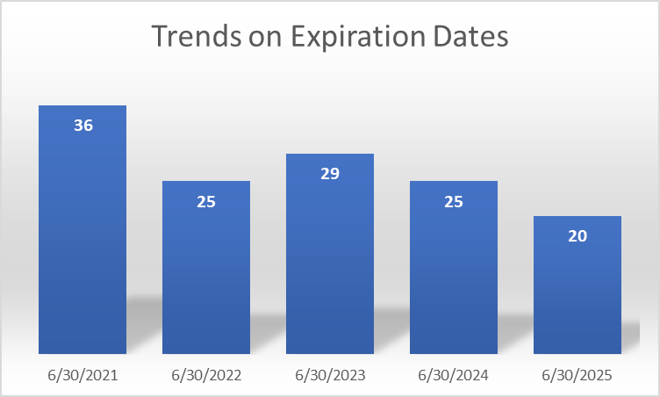
Class 7: Expire Trends

Slide 8
2020-2021 Class 7: Initial Licenses
Class 7: Endorsements | Number Initial Licenses Issued
Assiniboine K-12 (06Z ASB) | 1
Blackfeet K-12 (06Z BLA) | 7
Cheyenne K-12 (06Z CHE)
Chippewa K-12 (06Z CHI)
Cree K-12 (06Z CRE) | 1
Crow K-12 (06Z CRO)
Dakota K-12 (06Z DAK)
Gros Ventre K-12 (06Z GV)
Kootenai K-12 (06Z KOO)
Salish K-12 (06Z SAL)
TOTAL | 9

Slide 9
2020-2021 Class 7: Renewals
Class 7: Endorsements | Number Renewed Licenses
Assiniboine K-12 (06Z ASB) | 1
Blackfeet K-12 (06Z BLA) | 1
Cheyenne K-12 (06Z CHE) | 5
Chippewa K-12 (06Z CHI)
Cree K-12 (06Z CRE) | 2
Crow K-12 (06Z CRO) | 1
Dakota K-12 (06Z DAK)
Gros Ventre K-12 (06Z GV)
Kootenai K-12 (06Z KOO)
Salish K-12 (06Z SAL)
TOTAL | 10

Slide 10
Class 7: Rate of Renewal (2014-2019)
Class 7: Endorsements | Renewed at least once within the last 5 years (Current) | Renewed at least once (Expired) | One-5 year license-never renewed (Expired) | Approx. rate of renewal | Initial within last 5 years (Current) | Current Potential to renew (2021)
Assiniboine K-12 (06Z ASB) | 3 | 3 | 9 | 6/15=40% | 6 | 9
Blackfeet K-12 (06Z BLA) | 16 | 8 | 6 | 24/30=80% | 23 | 39
Cheyenne K-12 (06Z CHE) | 11 | 6 | 10 | 17/27=63% | 10 | 21
Chippewa K-12 (06Z CHI) | 0 | 0 | 2 | 0/2=0% | 5 | 5
Cree K-12 (06Z CRE) | 4 | 3 | 13 | 7/20=35% | 10 | 14
Crow K-12 (06Z CRO) | 7 | 5 | 13 | 12/25=48% | 13 | 20
Dakota K-12 (06Z DAK) | 2 | 1 | 0 | 3/3=100% | 3 | 5
Gros Ventre K-12 (06Z GV) | 4 | 0 | 2 | 4/6=67% | 3 | 7
Kootenai K-12 (06Z KOO) | 0 | 0 | 3 | 0/3=0% | 2 | 2
Salish K-12 (06Z SAL) | 3 | 1 | 4 | 4/8=50% | 10 | 13
TOTAL | 50 | 27 | 62/139=45% | 77/139=55% | 85 | 135

Slide 11
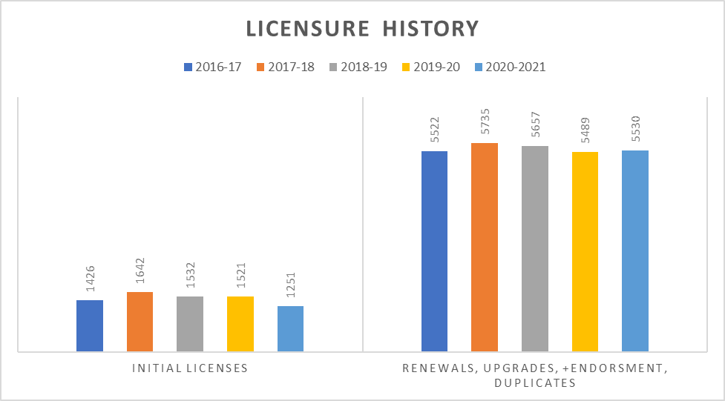
Licensure Trend Data

Slide 12
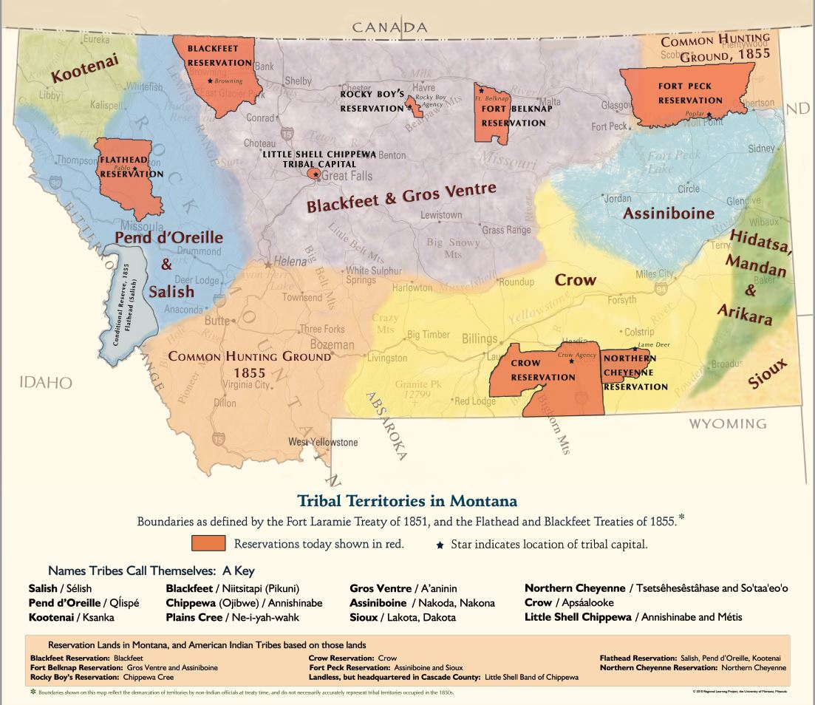
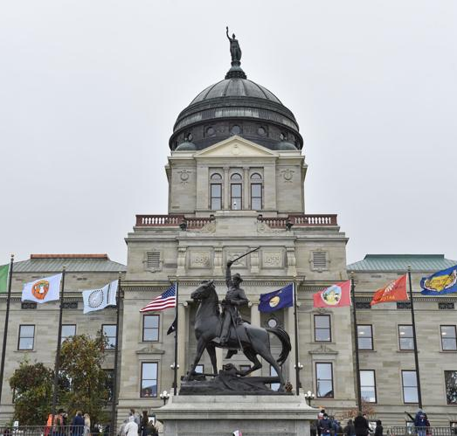
Tribal Council Rights and Responsibilities in Class 7

Slide 13
Tribal Responsibility for Class 7 Licensing
Tribal Council MOU with OPI: Verification by the authorized representative of a tribal government for applicant has met tribal standards for competency and fluency.
BPE will accept and place on file the criteria developed by each tribe for qualifying an individual as competent to be a specialist.
May be renewed upon verification by the tribe that the PD plan, as defined by the MOU is met.

Slide 14
MOUs
Varies from tribe to tribe
Northern Cheyenne Tribal Council Resolution designated Chief Dull Knife College to be responsible for development of curriculum, implementation, and administration of the program for certification and renewal. An examination is required and administered by a selected Board of Examiners who are fluent speakers of the Northern Cheyenne language, are certified Class 7 Licensed and Certificated Educators, and have an extensive knowledge of Cheyenne culture.
Kootenai and Salish/Pend d’Oreille Culture Committee Directors are authorized to design and administer language and culture examinations and approve and sign the applications.

Slide 15
Discussion
Questions
Recommendations

